Slide 1
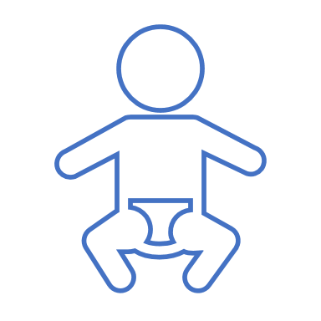
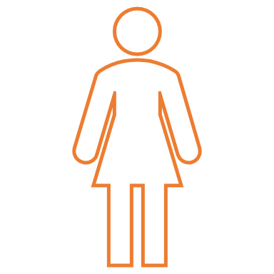
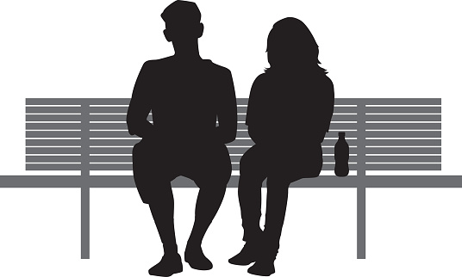
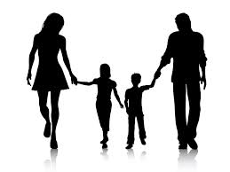
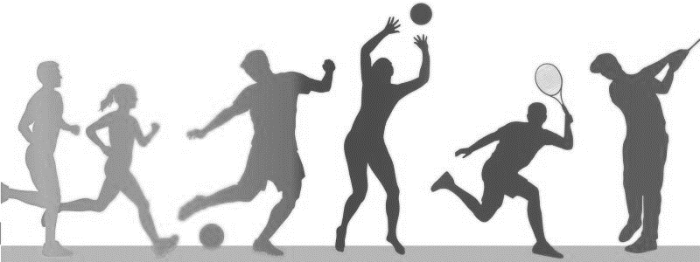
COMMUNITY PARK
[insert park name] was a run down public park located in Northeast Denver. In 2014, a local coalition partnered with community members to RE-ACTIVATE the park. Improvements included playground improvements, re-opening bathrooms, removing graffiti, revamping sidewalks, and hosting a walking program.
This report highlights the positive impact of the [insert park name] re-activation efforts.
110%
Average Number of Daily Park Visitors
INCREASE
in PARK VISITORS
from 2014-2017
396 PEOPLE
189 PEOPLE
+7%
NUMBER OF KIDS IN THE PARK
From 2014 to 2017:
# Park visitors doubled # females & kids increased
+3%
NUMBER OF females IN THE PARK
Park Visitors more physically active
in 2017 vs 2014
Sedentary Activity
(e.g. Sitting, Watching Kids)
Very Active
(e.g. Sport, Running)
Walking
(e.g. In Group, On Trail)
11%↓
were
21%↓
137%↑
[Logo or other footer here]

